Slide 1

Introduction Complete Search

Slide 2
Definition?
Problem solving is a set of steps and processes to be done to reach to output
Problem solving Steps:
Problem Definition : identify on output and input and arithmetic and logic operation to be done
Algorithm preparation : is one of method used to solve problem
Program design : Translate the flowchart to programming languages to solve it in computer
Program testing : discover program errors and correct them

Slide 3



What is the competitive programming?
Timing
Typing
Teamwork

Slide 4





Why should we learn competitive programming?

Slide 5




How to be ready?

Slide 6
Time Complixety
1
The efficiency of algorithms is important in competitive programming

Slide 7
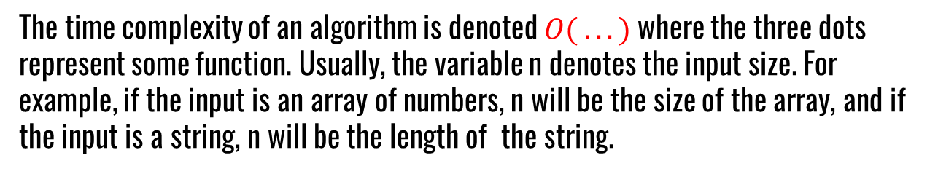
Time Complexity of an algorithm estimates how much time the algorithm will use for some input.
The time complexity of an algorithm is denoted $O( . . .)$where the three dots represent some function. Usually, the variable n denotes the input size. For example, if the input is an array of numbers, n will be the size of the array, and if the input is a string, n will be the length of the string.

Slide 8
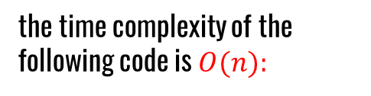
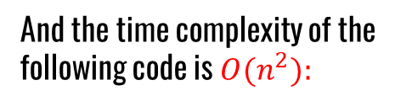
Calculation Rules
Loops: A common reason why an algorithm is slow is that it contains many loops that go through the input
the time complexity of the following code is $O(n):$
And the time complexity of the following code is $O(n^{2}):$
for (int i = 1; i <= n; i++) {
// code
}
for (int i = 1; i <= n; i++) {
for (int j = 1; j <= n; j++) {
// code
}
}

Slide 9
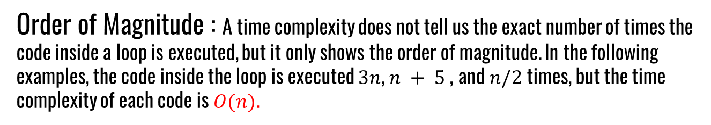
Calculation Rules
Order of Magnitude : A time complexity does not tell us the exact number of times the code inside a loop is executed, but it only shows the order of magnitude. In the following examples, the code inside the loop is executed $3n$, $n + 5$, and $n/2$times, but the time complexity of each code is $O(n).$
for (int i = 1; i <= n+5; i++) {
// code
}
for (int i = 1; i <= 3*n; i++) {
// code
}

Slide 10
Calculation Rules
Phases: If the algorithm consists of consecutive phases, the total time complexity is the largest time complexity of a single phase.
For example, the following code consists of three phases with time complexities
$O(n), O(n^{2})$and $O(n).$Thus, the total time complexity is $O\left(n + n^{2} + n \right)≈O(n^{2}).$
for (int i = 1; i <= n; i++) { // code }
for (int i = 1; i <= n; i++) {
for (int j = 1; j <= n; j++) { // code}
}
for (int i = 1; i <= n; i++) { // code}

Slide 11
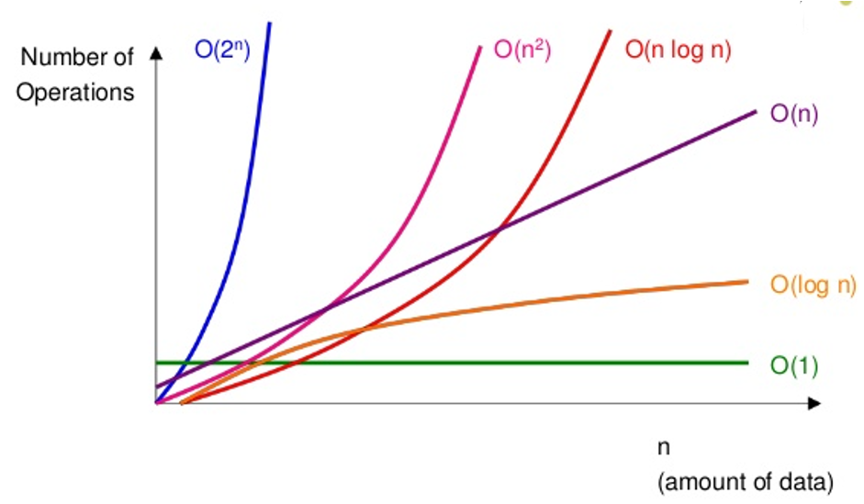
Calculation Rules
Complexity classes

Slide 12
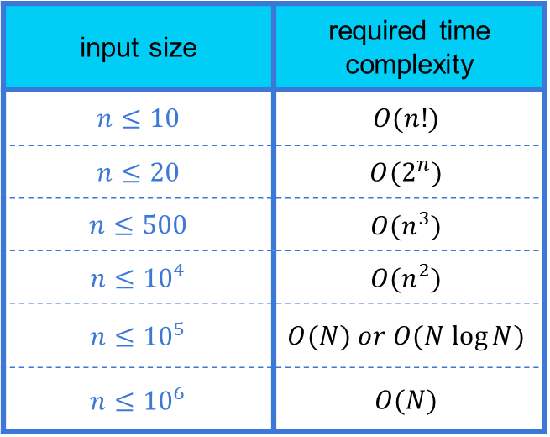
Calculation Rules
input size | required time complexity
$$n≤10$$ | $$O(n!)$$
$$n≤20$$ | $$O(2^{n})$$
$$n≤500$$ | $$O(n^{3})$$
$$n≤{10}^{4}$$ | $$O(n^{2})$$
$$n≤{10}^{5}$$ | $$O(N) or O(N log⁡N)$$
$$n≤{10}^{6}$$ | $$O(N)$$

Slide 13
Activity!

Slide 14
Sorting
2
Many efficient algorithms use sorting as a subroutine

Slide 15
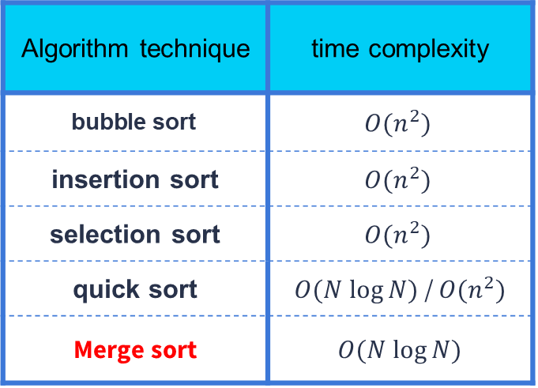
Sort Algorithms
Algorithm technique | time complexity
$$\text{bubble} \text{sort}$$ | $$O(n^{2})$$
insertion sort | $$O(n^{2})$$
selection sort | $$O(n^{2})$$
quick sort | $O(N log⁡N)$ / $O(n^{2})$
Merge sort | $O(N log⁡N)$

Slide 16
Merge sort
1 | 3 | 6 | 2 | 8 | 2 | 5 | 9
1 | 3 | 6 | 2
8 | 2 | 5 | 9
1 | 3
2 | 6
2 | 8
5 | 9
1 | 2 | 3 | 6
2 | 5 | 8 | 9

Slide 17
Built-in Functions
0ffx55 – 0ffx50 = 5
Memory | 0ffx50 | 0ffx51 | 0ffx52 | 0ffx53 | 0ffx54 | 0ffx55
Index | 0 | 1 | 2 | 3 | 4 | 5
Value | 1 | 3 | 12 | 8 | 3 | 2
Function uses memory pointer, so I have to pass first pointer and last pointer
sort( arr , arr + n )

Slide 18
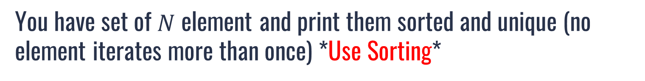
Practice Time
You have set of $N$ element and print them sorted and unique (no element iterates more than once) *Use Sorting*
Input
Output
8
3 5 3 3 1 2 1 2
1 2 3 5

Slide 19


Built-in Functions
min
max
Memory | 0ffx50 | 0ffx51 | 0ffx52 | 0ffx53 | 0ffx54 | 0ffx55
Value | 1 | 3 | 12 | 8 | 3 | 2
Function uses memory pointer, so function will return pointer to memory cell
$$\}$$
*max_element( arr , arr + n )
*min_element( arr , arr + n )
$$O(N)$$
reverse( arr , arr + n )
19

Slide 20
Mathematics
3
it is not possible to become a successful CP without having good mathematical skills.

Slide 21


Sum Formula
1 | 2 | 3 | 4 | 5 | 6 | 7 | 8 | 9
$$1 + 9 = 10$$
1 | 2 | 3 | 4 | 5 | 6 | 7 | 8 | 9
$$2 + 8 = 10$$

Slide 22


Sum Formula
1 | 2 | 3 | 4 | 5 | 6 | 7 | 8 | 9
$$3 + 7 = 10$$
1 | 2 | 3 | 4 | 5 | 6 | 7 | 8 | 9
$$4 + 6 = 10$$
22

Slide 23


Sum Formula
We noticed that each time sum between last and first is $N +1$
So, we have $\frac{N}{2}$ pair that sum is $(N+1)$ which mean:
$$\sum_{x=1}^{x=n}{x}=1+2+3+4……= \frac{N ∗(N+1 )}{2}$$

Slide 24
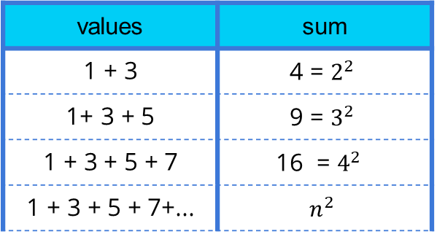
Sum of odd Formula
We noticed that the sum between odd values equal number of power 2
values | sum
$$\text{1 }\text{+ }\text{3}$$ | $$\text{4 }\text{= }2^{2}$$
$$\text{1}\text{+ }\text{3 }\text{+ }\text{5}$$ | $$\text{9 }\text{= }3^{2}$$
$$\text{1 }\text{+ }\text{3 }\text{+ }\text{5 }\text{+ }\text{7}$$ | $$\text{16 }\text{= }4^{2}$$
$$\text{1 }\text{+ }\text{3 }\text{+ }\text{5 }\text{+ }\text{7}\text{+...}$$ | $$n^{2}$$
The sum formula of odd values $\left[ 1 , N \right] is N^{2}$

Slide 25
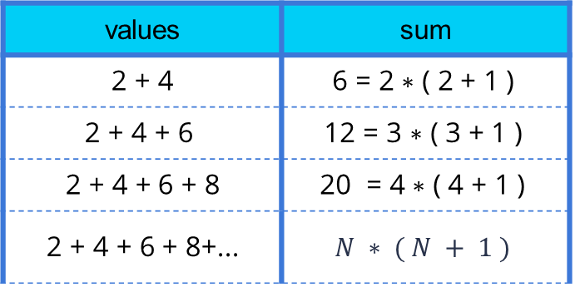
Sum of even Formula
We noticed that the sum between odd values equal number of power 2
values | sum
$$\text{2 }\text{+ }\text{4}$$ | $$\text{6} \text{=} \text{2 }\text{∗ }\text{( }\text{2 }\text{+ }\text{1 }\text{)}$$
$$\text{2 }\text{+ }\text{4 }\text{+ }\text{6 }$$ | $$\text{12} \text{=} \text{3 }\text{∗ }\text{( }\text{3 }\text{+ }\text{1 }\text{)}$$
$$\text{2 }\text{+ }\text{4 }\text{+ }\text{6 }\text{+ }\text{8}$$ | $$\text{20} \text{=} \text{4 }\text{∗ }\text{( }\text{4 }\text{+ }\text{1 }\text{)}$$
$$\text{2 }\text{+ }\text{4 }\text{+ }\text{6 }\text{+ }\text{8}\text{+...}$$ | $$N ∗ ( N + 1 )$$
The sum formula of even values $\left[ 1 , N \right] is N ∗ ( N + 1 )$
25

Slide 26
Greedy Algorithms
4
Greedy algorithms is strategy that making best choice at this moment

Slide 27
Greedy Strategy
A greedy algorithm constructs a solution to the problem by always making a choice that looks the best at the moment. A greedy algorithm never takes back its choices, but directly constructs the final solution. For this reason, greedy algorithms are usually very efficient.
The difficulty in designing greedy algorithms is to find a greedy strategy that always produces an optimal solution to the problem.

Slide 28
Problems
https://codeforces.com/problemset/problem/888/B
https://codeforces.com/problemset/problem/785/B
https://codeforces.com/problemset/problem/545/D
https://codeforces.com/contest/545/problem/B
https://codeforces.com/contest/270/problem/B

Slide 29
THANKS!
Any questions?

